Slide 1
AI for Medicine
Lecture 2:
AI Applications in Medicine
January 16, 2023
Mohammad Hammoud
Carnegie Mellon University in Qatar

Slide 2
Today…
Last Monday’s Session:
Introduction to AI
Today’s Session:
AI Applications in Medicine
Announcements:
Assignment 1 will be out by tonight and is due on Monday, Jan 30 by midnight
Submission is through Gradescope

Slide 3
Outline
Introduction
What is AI?
Administrivia
AI Applications in Medicine

Slide 4
Some Applications of AI in Medicine
Diagnosing diabetic eye disease using deep learning [1]
Detecting anemia from retinal fundus images using deep learning [2]
Predicting cardiovascular risk factors from retinal fundus photographs using deep learning [3]
Performing differential diagnosis using probabilistic graphical models [4]
Extracting symptoms and their status from clinical conversations using recurrent neural networks [5]
Predicting osteoarthritis using machine learning [6]

Slide 5
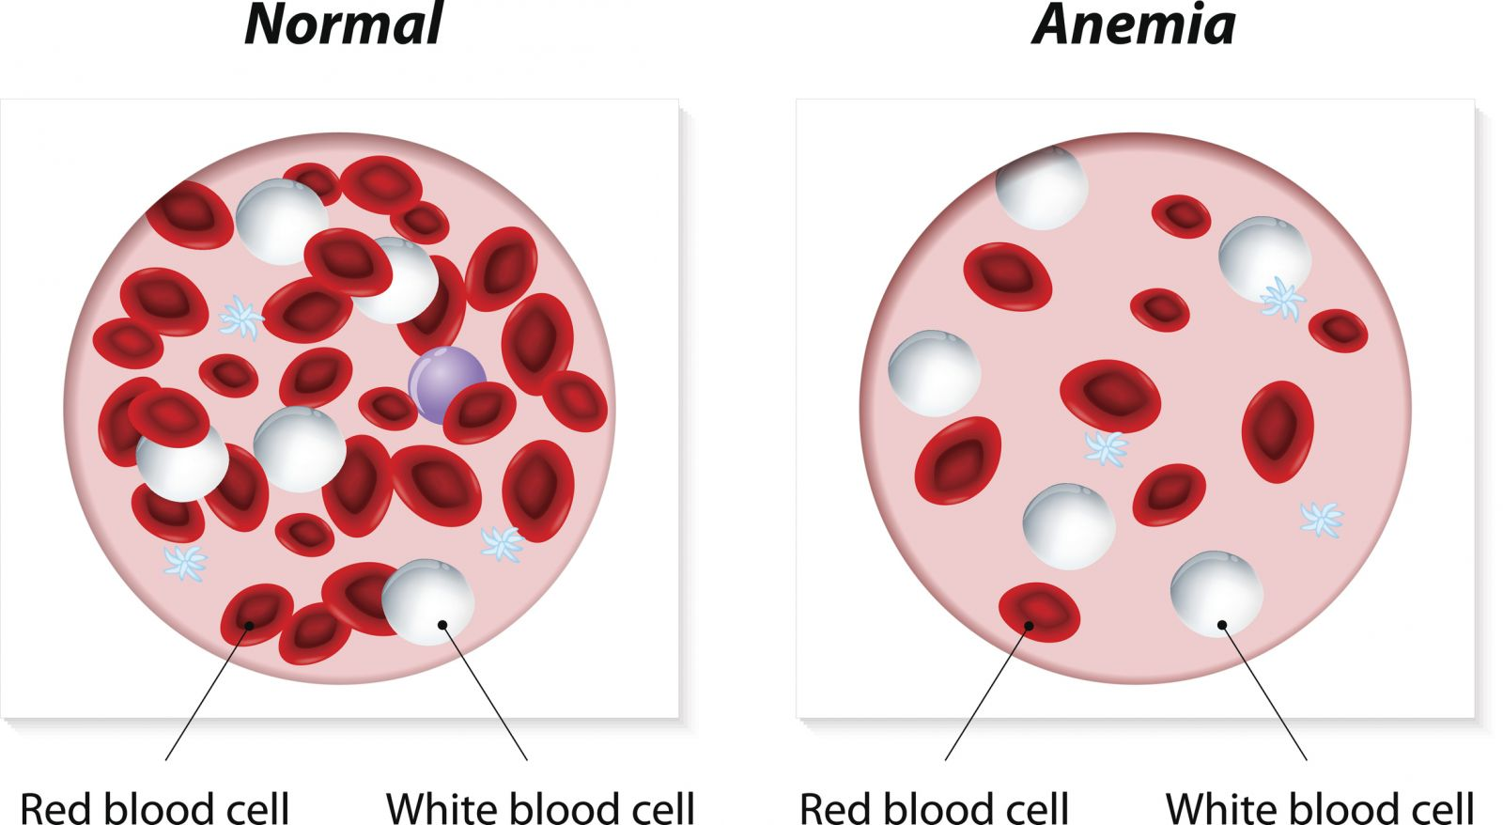
Detecting Anemia from Retinal Fundus Images Using Deep Learning
Anemia is a public health problem impacting an estimated 1.62 billion people and inducing far-reaching consequences on productivity and quality-of-life
Anemia is usually correctable; hence, timely detection and intervention are key!
Notes:
Anemia is a condition in which you lack enough healthy red blood cells to carry adequate oxygen to your body's tissues (red blood cells provide oxygen to body tissues).
Having anemia, also referred to as low hemoglobin, can make you feel tired and weak.
In 2011, 29% of non-pregnant women worldwide were affected by anaemia.

Slide 6
Detecting Anemia from Retinal Fundus Images Using Deep Learning
The most reliable indicator of anemia is hemoglobin concentration (Hb), which is measured using a venous or capillary blood sample
This is invasive & painful and can cause infection in patients & healthcare workers, let alone that it generates biohazardous waste
Noninvasive procedures are currently available or under exploration, but they are less accurate than the gold standard and represent trade-offs between invasiveness, time, cost and accuracy
Notes:
- Recently, it was reported that Hb can be estimated with high accuracy using automated algorithms to analyse the colour of fingernail beds from digital photographs taken by smartphones

Slide 7
Detecting Anemia from Retinal Fundus Images Using Deep Learning
Interestingly, anemia of sufficient severity has been known to manifest characteristic signs in the fundus of the eye
E.g., Retinopathy is observed in 28.3% of patients with anemia and/or thrombocytopenia, and low Hb was associated with the presence of retinopathy
The low prevalence of retinopathy among patients with anemia limits its potential sensitivity as a stand-alone diagnostic feature
Hence, fundus photographs have not been used to either detect anemia or quantify more precise Hb levels
Notes:
Thrombocytopenia is a condition in which you have a low blood platelet count.
Platelets (thrombocytes) are colorless blood cells that help blood clot. Platelets stop bleeding by clumping and forming plugs in blood vessel injuries.
Thrombocytopenia might occur as a result of a bone marrow disorder such as leukemia or an immune system problem. Or it can be a side effect of taking certain medications.

Slide 8
Detecting Anemia from Retinal Fundus Images Using Deep Learning
Google showed that Hb can be quantified and anemia can be detected using fundus photographs and deep learning
They conducted a study on data from the UK Biobank with a total of 114,205 fundus images from 57,163 study participants
Among all the participants, 3.7% had anemia, with Hb ranging from 6.4 g dl^{–1} to 19.6 g dl^{–1}
Metadata such as demographics, sex, and age were considered

Slide 9
Detecting Anemia from Retinal Fundus Images Using Deep Learning
To this end, they developed 3 machine learning models:
A metadata-only (linear regression– will be discussed later in the semester) model to ensure that their predictors were not solely predicting Hb measurements based on age and sex
A fundus-only deep learning model, which uses fundus images
A combined model, which uses both metadata and fundus images

Slide 10
Detecting Anemia from Retinal Fundus Images Using Deep Learning
Results of the fundus-only model:
Red and white areas represent regions the model was positively influenced by
Red indicates a stronger contribution than white
Blue regions have little to no contribution towards the prediction
The model correctly predicts moderate anemia in each case

Slide 11
Detecting Anemia from Retinal Fundus Images Using Deep Learning
A Preamble: Receiver Operator Characteristic (ROC) and Area Under the Curve (AUC)
No Anemia
Each circle represents a person
Anemia
Hb

Slide 12
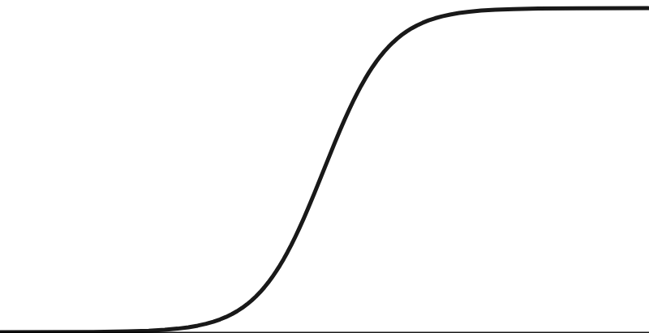
Detecting Anemia from Retinal Fundus Images Using Deep Learning
A Preamble: Receiver Operator Characteristic (ROC) and Area Under the Curve (AUC)
No Anemia
A logistic regression curve
(will be covered later in the semester)
Anemia
Hb

Slide 13
Detecting Anemia from Retinal Fundus Images Using Deep Learning
A Preamble: Receiver Operator Characteristic (ROC) and Area Under the Curve (AUC)
1
When we build a logistic regression model (or classifier) the y-axis is converted to
a probability that indicates whether a person has anemia
0
Hb

Slide 14
Detecting Anemia from Retinal Fundus Images Using Deep Learning
A Preamble: Receiver Operator Characteristic (ROC) and Area Under the Curve (AUC)
1
But to do classification, we need to transform probabilities into classes (Anemia vs. No Anemia)
0
Hb

Slide 15
Detecting Anemia from Retinal Fundus Images Using Deep Learning
A Preamble: Receiver Operator Characteristic (ROC) and Area Under the Curve (AUC)
1
For this sake, we can use
a threshold with a certain
value (e.g., if pr <= 0.5,
the person has Anemia;
else, No Anemia)
0
Hb

Slide 16
Detecting Anemia from Retinal Fundus Images Using Deep Learning
A Preamble: Receiver Operator Characteristic (ROC) and Area Under the Curve (AUC)
1
For this sake, we can use
a threshold with a certain
value (e.g., if pr <= 0.5,
the person has Anemia;
else, No Anemia)
Threshold = 0.5
Probability <= 0.5 ➔ Anemia
0
Hb

Slide 17
Detecting Anemia from Retinal Fundus Images Using Deep Learning
A Preamble: Receiver Operator Characteristic (ROC) and Area Under the Curve (AUC)
1
For this sake, we can use
a threshold with a certain
value (e.g., if pr <= 0.5,
the person has Anemia;
else, No Anemia)
Probability > 0.5 ➔ No Anemia
Threshold = 0.5
0
Hb

Slide 18
Detecting Anemia from Retinal Fundus Images Using Deep Learning
A Preamble: Receiver Operator Characteristic (ROC) and Area Under the Curve (AUC)
In this example, and with a threshold/cutoff of 0.5,
all the people with no anemia
(i.e., represented by the green
circles) will be classified as No Anemia
1
For this sake, we can use
a threshold with a certain
value (e.g., if pr <= 0.5,
the person has Anemia;
else, No Anemia)
Threshold = 0.5
0
Hb

Slide 19
Detecting Anemia from Retinal Fundus Images Using Deep Learning
A Preamble: Receiver Operator Characteristic (ROC) and Area Under the Curve (AUC)
1
For this sake, we can use
a threshold with a certain
value (e.g., if pr <= 0.5,
the person has Anemia;
else, No Anemia)
Threshold = 0.5
… and all the people with anemia (i.e., represented by the red circles) will be classified as Anemia
0
Hb

Slide 20
Detecting Anemia from Retinal Fundus Images Using Deep Learning
A Preamble: Receiver Operator Characteristic (ROC) and Area Under the Curve (AUC)
1
But, what if we change the threshold to 0.2?
Threshold = 0.5
0
Hb

Slide 21
Detecting Anemia from Retinal Fundus Images Using Deep Learning
A Preamble: Receiver Operator Characteristic (ROC) and Area Under the Curve (AUC)
1
But, what if we change the threshold to 0.2?
Probability > 0.2 ➔ No Anemia ➔ False Negative
Threshold = 0.2
0
Hb

Slide 22
Detecting Anemia from Retinal Fundus Images Using Deep Learning
A Preamble: Receiver Operator Characteristic (ROC) and Area Under the Curve (AUC)
1
What if we change the threshold to 0.9?
Threshold = 0.2
0
Hb

Slide 23
Detecting Anemia from Retinal Fundus Images Using Deep Learning
A Preamble: Receiver Operator Characteristic (ROC) and Area Under the Curve (AUC)
1
Threshold = 0.9
What if we change the
threshold to 0.9?
Probability < 0.9 ➔ Anemia ➔ False Positive
0
Hb
Notes:
If it is super important to correctly classify every person with anemia, we can increase the threshold but that will cause an increase in false positives

Slide 24
Detecting Anemia from Retinal Fundus Images Using Deep Learning
A Preamble: Receiver Operator Characteristic (ROC) and Area Under the Curve (AUC)
1
What is the best threshold value?
0
Hb

Slide 25
Detecting Anemia from Retinal Fundus Images Using Deep Learning
A Preamble: Receiver Operator Characteristic (ROC) and Area Under the Curve (AUC)
1
We can consider many
threshold values and
compute the sensitivity and specificity (or alternatively precision) per each value
0
Hb
Notes:
For each threshold, we can build a confusion matrix
But we might wind up with a great deal of confusion matrices
Instead of being overwhelmed with confusion matrices, we can use an ROC graph to summarize all the results in a simple way

Slide 26
Detecting Anemia from Retinal Fundus Images Using Deep Learning
A Preamble: Receiver Operator Characteristic (ROC) and Area Under the Curve (AUC)
1
Afterwards, we can summarize all the results under all the threshold
values using an ROC graph
0
Hb

Slide 27
Detecting Anemia from Retinal Fundus Images Using Deep Learning
A Preamble: Receiver Operator Characteristic (ROC) and Area Under the Curve (AUC)
1
This is when the
TPR = 1 and FPR = 1
Afterwards, we can summarize all the results under all the threshold
values using an ROC graph
True Positive Rate
(Sensitivity)
Even though we correctly classified all the anemic people, we incorrectly classified all the non-anemic people
(0,0)
False Positive Rate
(1- Specificity)
1

Slide 28
Detecting Anemia from Retinal Fundus Images Using Deep Learning
A Preamble: Receiver Operator Characteristic (ROC) and Area Under the Curve (AUC)
1
This is where
True Positive Rate =
False Positive Rate
Afterwards, we can summarize all the results under all the threshold
values using an ROC graph
True Positive Rate
(Sensitivity)
Any point on this line means that the proportion
of correctly classified anemic people is the same
as the proportion of incorrectly classified non-anemic ones
(0,0)
False Positive Rate
(1- Specificity)
1
Notes:
True positive rate tells you what proportion of anemic people were correctly classified
False positive rate (FP/(FP+TN)) tells you what proportion of non-anemic people were incorrectly classified

Slide 29
Detecting Anemia from Retinal Fundus Images Using Deep Learning
A Preamble: Receiver Operator Characteristic (ROC) and Area Under the Curve (AUC)
1
ROC
Afterwards, we can summarize all the results under all the threshold
values using an ROC graph
True Positive Rate
(Sensitivity)
(0,0)
False Positive Rate
(1- Specificity)
1

Slide 30
Detecting Anemia from Retinal Fundus Images Using Deep Learning
A Preamble: Receiver Operator Characteristic (ROC) and Area Under the Curve (AUC)
1
Afterwards, we can summarize all the results under all the threshold
values using an ROC graph
The larger the AUC,
the better!
True Positive Rate
(Sensitivity)
AUC
(0,0)
False Positive Rate
(1- Specificity)
1

Slide 31
Detecting Anemia from Retinal Fundus Images Using Deep Learning
Using a validation dataset of 11,388 participants from the UK Biobank
The metadata-only predicted Hb with mean absolute error value (MAEV) of 0.73 and Area Under the Receiver Operating Characteristic Curve (AUC) 0.74
The fundus-image-only predicted Hb with MAEV = 0.67 & AUC = 0.87
The combined model predicted Hb with MAEV =0.63 & AUC = 0.88
The combined model predicted Hb, HCT and RBC more accurately than either the fundus-only or metadata-only models
This indicates that both, metadata and fundus images are important for accurate prediction
Notes:
A hemoglobin test measures the amount of hemoglobin in your blood. Hemoglobin is a protein in your red blood cells that carries oxygen to your body's organs and tissues and transports carbon dioxide from your organs and tissues back to your lungs.
A hematocrit test (Hct) is a simple blood test that measures the percentage of red blood cells in your blood. Red blood cells are important because they carry oxygen throughout your body. Test results showing low or high hematocrit levels may be signs of blood disorders or other medical conditions.
A red blood cell (RBC) count measures the number of red blood cells, also known as erythrocytes, in your blood.

Slide 32
Detecting Anemia from Retinal Fundus Images Using Deep Learning
What does this study entail?
An AI approach that leverages retinal fundus images and metadata can detect anemia and quantify Hb measurements, potentially enabling automated anemia screening using fundus images
Since fundus photographs are routinely captured as part of screening for diabetic retinopathy, the ability to predict Hb from these photographs may also enable seamless anemia screening with minimal additional cost
This is important because anemia is twice as common in patients with diabetes

Slide 33
Some Applications of AI in Medicine
Diagnosing diabetic eye disease using deep learning [1]
Detecting anemia from retinal fundus images using deep learning [2]
Predicting cardiovascular risk factors from retinal fundus photographs using deep learning [3]
Performing differential diagnosis using probabilistic graphical models [4]
Extracting symptoms and their status from clinical conversations using recurrent neural networks [5]
Predicting osteoarthritis using machine learning [6]

Slide 34
Predicting Cardiovascular Risk Factors from Retinal Fundus Photographs Using Deep Learning
Cardiovascular diseases remain the leading cause of death globally
The screening standard for cardiovascular disease risk requires a variety of parameters such as age, gender, smoking status, blood pressure, BMI, glucose, and cholesterol levels
Most cardiovascular risk calculators use some combination of these parameters to identify patients at risk of experiencing a major cardiovascular event or cardiac-related mortality within a pre-specified time period (e.g., 10 years)

Slide 35
Predicting Cardiovascular Risk Factors from Retinal Fundus Photographs Using Deep Learning
However, some of these parameters may be unavailable
E.g., A study from the Practice INNovation And CLinical Excellence (PINNACLE) electronic-health-record-based cardiovascular registry (a large US nationwide registry) showed that:
The data required to calculate the 10-year risk scores were available for less than 30% of the patients
This was largely due to missing cholesterol values (which is not surprising given that a fasting blood draw is required to obtain these data)

Slide 36
Predicting Cardiovascular Risk Factors from Retinal Fundus Photographs Using Deep Learning
Markers of cardiovascular disease, such as hypertensive retinopathy and cholesterol emboli, can often manifest in the eye
Besides, since blood vessels can be visualized from retinal fundus images, various features in the retina (e.g., vessel calibre, vascular fractal dimensions, etc.), may reflect the systemic health of the cardiovascular system as well as future risk
Caveat: The clinical utility of such features still requires further study

Slide 37
Predicting Cardiovascular Risk Factors from Retinal Fundus Photographs Using Deep Learning
Google trained Deep Learning models on retinal images from 284,335 patients and validated them on 2 datasets of 12,026 and 999 patients
Results showed that cardiovascular risk factors such as age, gender, smoking status, and systolic blood pressure can be predicted better than the baseline
Moreover, one model was able to predict the onset of major adverse cardiovascular events (MACE) within five years
The model achieved an AUC of 0.70 from retinal fundus images alone, comparable to an AUC of 0.72 using the composite European SCORE risk calculator

Slide 38
Predicting Cardiovascular Risk Factors from Retinal Fundus Photographs Using Deep Learning
Original
Age
Gender
Smoking
HbA1c
BMI
Attention maps demonstrate
that the model is paying
attention to the vascular
regions in the retina to
predict several variables
associated with
cardiovascular risk
SBP
DBP

Slide 39
Predicting Cardiovascular Risk Factors from Retinal Fundus Photographs Using Deep Learning
Original
Age
Gender
Smoking
HbA1c
BMI
Actual: 57.6 years
Predicted: 59.1 years
Actual: female
Predicted: female
Actual: non-smoker
Predicted: non-smoker
Actual: non-diabetic
Predicted: 6.7%
Actual: 26.3 kg m^{–2}
Predicted: 24.1 kg m^{–2}
SBP
DBP
Actual: 78.5 mmHg
Predicted: 86.6 mmHg
Actual: 148.5 mmHg
Predicted: 148.0 mmHg

Slide 40
Predicting Cardiovascular Risk Factors from Retinal Fundus Photographs Using Deep Learning
Original
Age
Gender
Smoking
HbA1c
BMI
Summary:
The application of Deep Learning
to retinal fundus images alone
can be used to predict
multiple cardiovascular
risk factors, including age,
gender and SBP, among others
SBP
DBP

Slide 41
Next Lecture…
AI Applications in Medicine – Part II

Slide 42
References
Gulshan, Varun, et al. "Development and validation of a deep learning algorithm for detection of diabetic retinopathy in retinal fundus photographs." Jama 316.22 (2016): 2402-2410.
Mitani, Akinori, et al. "Detection of anaemia from retinal fundus images via deep learning." Nature Biomedical Engineering 4.1 (2020): 18-27.
Poplin, R., et al. "Predicting cardiovascular risk factors from retinal fundus photographs using deep learning.” arXiv preprint arXiv:1708.09843.
Hammoud, M., et al. “Avey: An Accurate AI Algorithm for Self-Diagnosis.” medRxiv 2022
Du, Nan, et al. "Extracting symptoms and their status from clinical conversations." arXiv preprint arXiv:1906.02239 (2019).
Kundu, Shinjini, et al. "Discovery and visualization of structural biomarkers from MRI using transport-based morphometry." NeuroImage 167 (2018): 256-275.

